Slide 1
WebJunction is the learning place for libraries
online learning network
free continuing education for all
initiatives to scale learning and innovation
Notes:
STEPH
The range of resources on our website includes weekly articles and stories on library-related topics, and free live webinars every month. We record these webinars so you can watch them again, or watch them later. We currently have about 390 webinars in our catalog! library-related topics.
It also includes on-demand courses – and this is actually one of the biggest parts of our work, developing on-demand training for library staff, and you’ll find 61 courses in our online course catalog.
Activity: Ask for a show of hands for folks who’ve used WJ’s learning resources – taken a course, watched a webinar, downloaded a report or a toolkit…
Anyone who’s heard of WJ but hasn’t explored it? Anyone who’s never heard of it?

Slide 2
Free learning events and resources at WebJunction.org
Live webinars 2x/month
Library-related, on-demand, online courses
New articles and stories each week
Crossroads e-newsletter 2x/month
Social media engagement
Research on trends in learning and libraries
Notes:
STEPH
The range of resources on our website includes weekly articles and stories on library-related topics, and free live webinars every month. We record these webinars so you can watch them again, or watch them later. We currently have about 390 webinars in our catalog! library-related topics.
It also includes on-demand courses – and this is actually one of the biggest parts of our work, developing on-demand training for library staff, and you’ll find 61 courses in our online course catalog.
Activity: Ask for a show of hands for folks who’ve used WJ’s learning resources – taken a course, watched a webinar, downloaded a report or a toolkit…
Anyone who’s heard of WJ but hasn’t explored it? Anyone who’s never heard of it?

Slide 3
Getting started at your library with a Misinformation Escape Room
Webinar recording on WebJunction
Slides
Backgrounder explaining University of Washington project
4-minute video
www.webjunction.org/events/webjunction/misinformation-escape-room
Notes:
STEPH
The range of resources on our website includes weekly articles and stories on library-related topics, and free live webinars every month. We record these webinars so you can watch them again, or watch them later. We currently have about 390 webinars in our catalog! library-related topics.
It also includes on-demand courses – and this is actually one of the biggest parts of our work, developing on-demand training for library staff, and you’ll find 61 courses in our online course catalog.
Activity: Ask for a show of hands for folks who’ve used WJ’s learning resources – taken a course, watched a webinar, downloaded a report or a toolkit…
Anyone who’s heard of WJ but hasn’t explored it? Anyone who’s never heard of it?

Slide 4
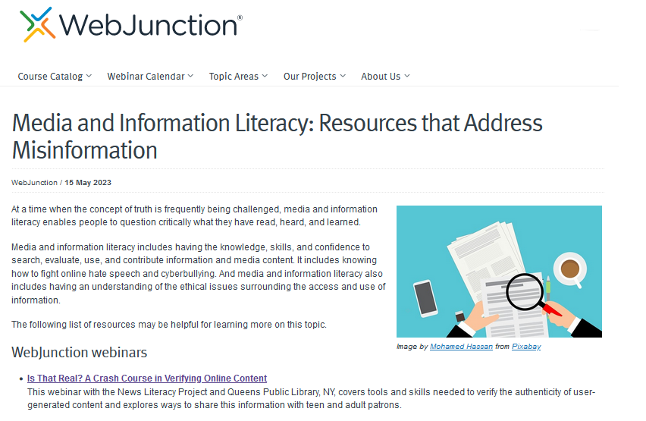
Further resources on WebJunction
Webinars
Stories from libraries with programs on media and information literacy
Resource list highlighting other free online tools and guides
https://oc.lc/media-info-literacy
Notes:
STEPH
The range of resources on our website includes weekly articles and stories on library-related topics, and free live webinars every month. We record these webinars so you can watch them again, or watch them later. We currently have about 390 webinars in our catalog! library-related topics.
It also includes on-demand courses – and this is actually one of the biggest parts of our work, developing on-demand training for library staff, and you’ll find 61 courses in our online course catalog.
Activity: Ask for a show of hands for folks who’ve used WJ’s learning resources – taken a course, watched a webinar, downloaded a report or a toolkit…
Anyone who’s heard of WJ but hasn’t explored it? Anyone who’s never heard of it?

